Slide 1
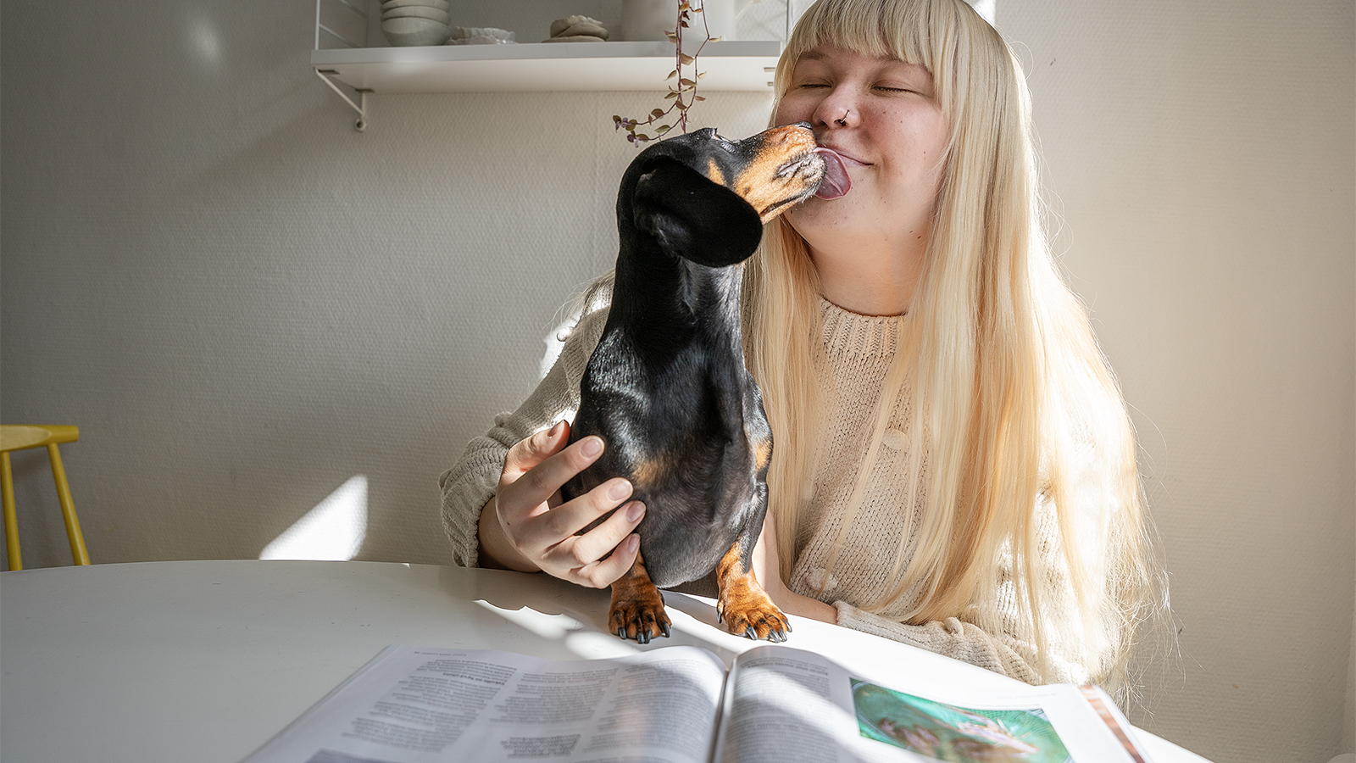

Reading times & number of readings of Magazines
Finnish National Readership Survey (NRS) 2023

Slide 2
Contents
01
Reading times by magazine group
02
Number of readings by magazine group
03
Longest read magazines
Finnish National Readership Survey 2023

Slide 3

On average, 53 minutes is spent reading a magazine issue.
The reading times rose in every magazine group from previous year.
Source: Finnish National Readership Survey 2023
Total population N: 46,862

Slide 4
Reading times by magazine group
Average amount of time spent on one issue, averages by magazine group
Magazine group | Total 15+ population, average reading times | Change from previous measurement (NRS 2022)
General interest magazines | 1 h 10 min | +13 min
Women's magazines | 1 h 7 min | +2 min
Health and well-being magazines | 1 h 6 min | +2 min
Hobby magazines | 1 h 5 min | +2 min
Housing, construction and gardening magazines | 58 min | +2 min
Motoring and technical magazines | 57 min | +2 min
Food and drink magazines | 54 min | +1 min
Economy and business magazines | 51 min | +4 min
Professional magazines and magazines published by non-profit organisations | 48 min | +1 min
Customer magazines | 37 min | +1 min
All magazines | 53 min | +0 min
Source: Finnish National Readership Survey 2023 | Total population N: 46,862, women N: 23,130, men N: 23,732

Slide 5
Reading times by magazine group
Average amount of time spent on one issue, averages by magazine group
Magazine group | Women, average reading times, NRS 2023
General interest magazines | 1 h 16 min
Women's magazines | 1 h 12 min
Health and well-being magazines | 1 h 11 min
Hobby magazines | 1 h 6 min
Housing, construction & gardening magazines | 1 h 2 min
Food and drink magazines | 60 min
Economy and business magazines | 50 min
Professional magazines and magazines published by non-profit organisations | 40 min
Customer magazines | 40 min
Motoring and technical magazines | 35 min
All magazines | 57 min
Magazine group | Men, average reading times, NRS 2023
Hobby magazines | 1 h 3 min
Motoring and technical magazines | 1 h 1 min
General interest magazines | 60 min
Professional magazines and magazines published by non-profit organisations | 53 min
Economy and business magazines | 52 min
Health and well-being magazines | 48 min
Housing, construction & gardening magazines | 46 min
Women's magazines | 39 min
Food and drink magazines | 39 min
Customer magazines | 30 min
All magazines | 49 min
Source: Finnish National Readership Survey 2023 | Total population N: 46,862, women N: 23,130, men N: 23,732

Slide 6
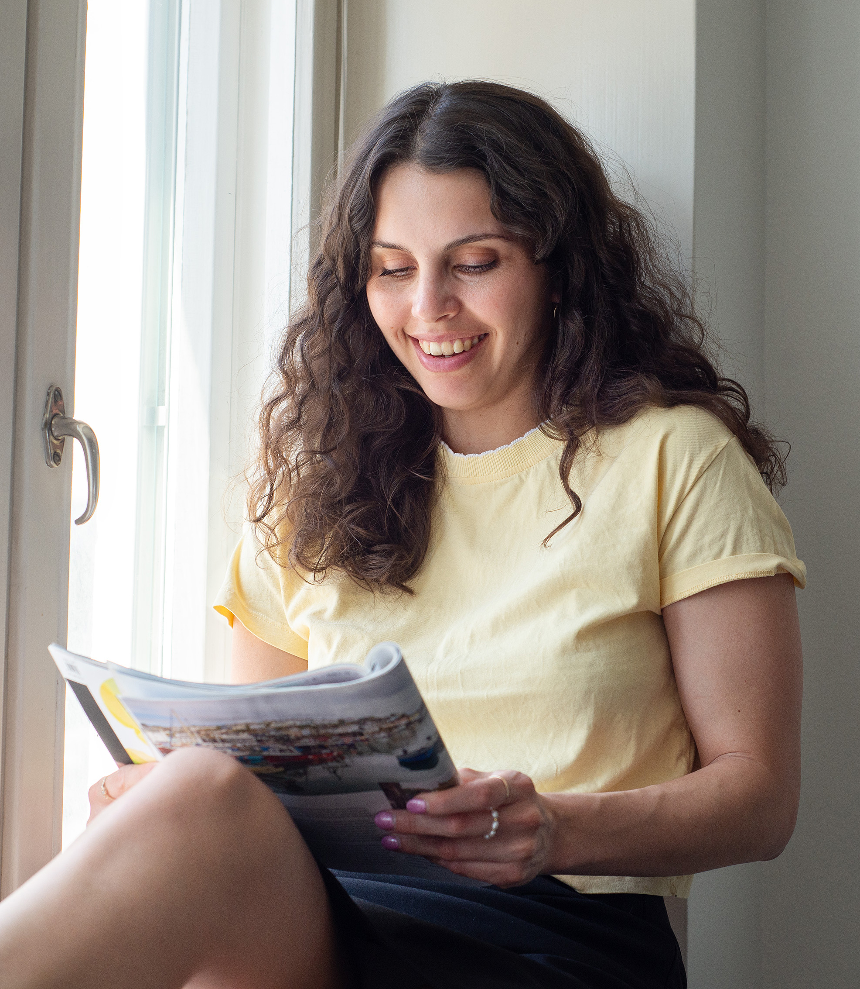
On average, one issue of a magazine is taken 2.1 times.
Food and beverage magazines (2.8 readings) and hobby magazines (2.5 readings) receive the highest number of readings.
There is no great variation in the number of readings of magazines in different magazine groups; even customer magazines that collect the least readings are viewed an average of 1.5 times.
Source: Finnish National Readership Survey 2023
Total population N: 46,862

Slide 7
Number of readings by magazine group
Average number of readings per magazine issue, average by magazine group
Magazine group | Total 15+ population, average number of readings | Women, average number of readings | Men, average number of readings
Food and drink magazines | 2,8 | 3.0 | 2.1
Hobby magazines | 2.5 | 2.2 | 2.3
Housing, construction & gardening magazines | 2.3 | 2.4 | 1.9
General interest magazines | 2.2 | 2.3 | 2.2
Health and well-being magazines | 2.2 | 2.2 | 1.8
Motoring and technical magazines | 2.2 | 1.7 | 2.2
Women's magazines | 2.1 | 2.2 | 1.6
Professional magazines and magazines published by non-profit organisations | 1.9 | 1.6 | 2.1
Economy and business magazines | 1.9 | 1.7 | 1.9
Customer magazines | 1.5 | 1.6 | 1.4
All magazines | 2.1 | 2.1 | 2.0
Source: Finnish National Readership Survey 2023 | Total population N: 46,862, women N: 23,130, men N: 23,732

Slide 8
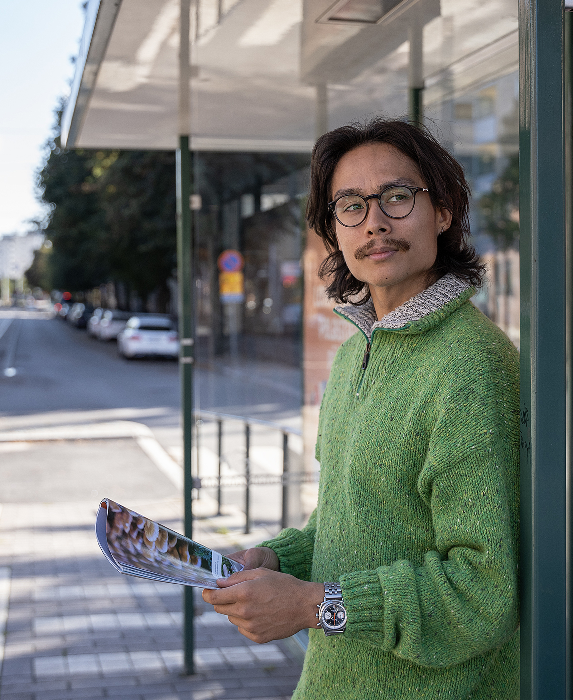
The magazines read the longest are enjoyed for over an hour.
Suomen Kuvalehti is the magazine with the longest reading time (1 h 30 min).

Slide 9
Longest read magazines
Average time spent on one issue, averages by magazine
Magazine | Reading time, 15+ population
Suomen Kuvalehti | 1 h 30 min
Image | 1 h 26 min
Eeva | 1 h 24 min
ET | 1 h 23 min
Tiede | 1 h 21 min
Apu | 1 h 20 min
Valitut Palat | 1 h 18 min
Suomen Luonto | 1 h 15 min
Voi Hyvin | 1 h 15 min
Average | 53 min
Magazine | Reading time, women
Image | 1 h 35 min
Suomen Kuvalehti | 1 h 33 min
ET | 1 h 31 min
Tiede | 1 h 29 min
Eeva | 1 h 29 min
Suomen Luonto | 1 h 26 min
Viva | 1 h 26 min
Apu | 1 h 23 min
Valitut Palat | 1 h 23 min
Kotiliesi | 1 h 21 min
Average | 55 min
Magazine | Reading time, men
Suomen Kuvalehti | 1 h 28 min
Apu | 1 h 16 min
Tiede | 1 h 16 min
Valitut Palat | 1 h 12 min
Tekniikan Maailma | 1 h 12 min
Mikrobitti | 1 h 11 min
Caravan | 1 h 11 min
Image | 1 h 10 min
Tiede Luonto | 1 h 8 min
IS Urheilulehti | 1 h 8 min
Average | 49 min
Source: Finnish National Readership Survey 2023 | Total population N: 46,862, women N: 23,130, men N: 23,732

Slide 10
Longest read magazines by magazine group
Average time spent on one issue, averages by magazine
Consumer magazines | Reading time, 15+ population
Suomen Kuvalehti | 1 h 30 min
Image | 1 h 26 min
Eeva | 1 h 24 min
ET-lehti | 1 h 23 min
Tiede | 1 h 21 min
Viva | 1 h 21 min
Apu | 1 h 20 min
Valitut Palat | 1 h 18 min
Suomen Luonto | 1 h 15 min
Voi Hyvin | 1 h 15 min
Average | 1 h 3 min
Professional magazines and magazines published by non-profit organisations | Reading time, 15+ population
Käytännön Maamies | 57 min
Koneviesti | 52 min
Aarre | 52 min
Metsälehti | 51 min
Maatilan Pellervo | 50 min
Opettaja | 35 min
Average | 48 min
Customer magazines | Reading time, 15+ population
Pirkka | 39 min
Yhteishyvä | 38 min
Samarbete | 37 min
Terveydeksi! | 33 min
Avainapteekit | 30 min
Average | 37 min
Source: Finnish National Readership Survey 2023 | Total population N: 46,862

Slide 11
Longest read magazines by magazine group
Average time spent on one issue, averages by magazine
Housing, construction and gardening | Reading time, 15+ population
Viherpiha | 1 h 12 min
Kotipuutarha | 1 h 9 min
Maalla | 1 h 4 min
Antiikki & Design | 1 h 3 min
Avotakka | 59 min
Meidän Mökki | 58 min
Unelmien Talo&Koti | 54 min
TM Rakennusmaailma | 52 min
Koti ja Keittiö | 52 min
Oma Piha | 51 min
Average | 58 min
Motoring and technical magazines | Reading time, 15+ population
Tekniikan Maailma | 1 h 7 min
Mikrobitti | 1 h 6 min
Vauhdin Maailma | 55 min
Tivi | 54 min
Tuulilasi | 53 min
Auto Bild Suomi | 51 min
Moottori | 50 min
Average | 57 min
Hobby magazines | Reading time, 15+ population
Tiede | 1 h 21 min
Suomen Luonto | 1 h 15 min
Suuri Käsityö | 1 h 14 min
Tiede Luonto | 1 h 9 min
Caravan | 1 h 6 min
IS Urheilulehti | 1 h 4 min
Juoksija-lehti | 1 h 3 min
Kotiliesi Käsityö | 1 h 3 min
Metsästys ja Kalastus | 58 min
Erä | 57 min
Average | 65 min
Source: Finnish National Readership Survey 2023 | Total population N: 46,862

Slide 12
Longest read magazines by magazine group
Average time spent on one issue, averages by magazine
Women's magazines | Reading time, 15+ population
Eeva | 1 h 24 min
Kotiliesi | 1 h 14 min
Kodin Kuvalehti | 1 h 8 min
Kodin Pellervo | 1 h 5 min
Me Naiset | 60 min
Anna | 58 min
Kotivinkki | 57 min
Trendi | 50 min
Gloria | 49 min
Average | 1 h 7 min
Food and drink magazines | Reading time, 15+ population
Glorian ruoka & viini | 55 min
Maku | 53 min
Average | 54 min
Economy and business magazines | Reading time, 15+ population
Taloustaito | 53 min
Arvopaperi | 52 min
Viisas Raha | 52 min
Talouselämä | 51 min
Tekniikka&Talous | 41 min
Average | 51 min
Source: Finnish National Readership Survey 2023 | Total population N: 46,862

Slide 13
Longest read magazines by magazine group
Average time spent on one issue, minutes, averages by magazine
Health and well-being magazines | Reading time, 15+ population
Voi Hyvin | 1 h 15 min
Apu Terveys | 1 h 13 min
ET Terveys | 1 h 9 min
Hyvä terveys | 1 h 4 min
Kotilääkäri | 1 h 1 min
Kauneus & Terveys | 56 min
Average | 1 h 6 min
General interest magazines | Reading time, 15+ population
Suomen Kuvalehti | 1 h 30 min
Image | 1 h 26 min
ET-lehti | 1 h 23 min
Viva | 1 h 21 min
Apu | 1 h 20 min
Valitut Palat | 1 h 18 min
Seura | 1 h 12 min
HS Meidän Perhe | 1 h 7 min
Askel | 1 h 6 min
Alibi | 1 h 3 min
Average | 1 h 10 min
Source: Finnish National Readership Survey 2023 | Total population N: 46,862

Slide 14
The Finnish National Readership Survey (NRS) figures for individual magazines can be obtained without registration from Magazine Rate Card service:
www.ratecards.fi
More summaries from the NRS in
Finnish Magazine Media Association’s website:
www.aikakausmedia.fi/en/research

Slide 15
Aikakausmedia.fi/en │ Ratecards.fi

